Slide 1
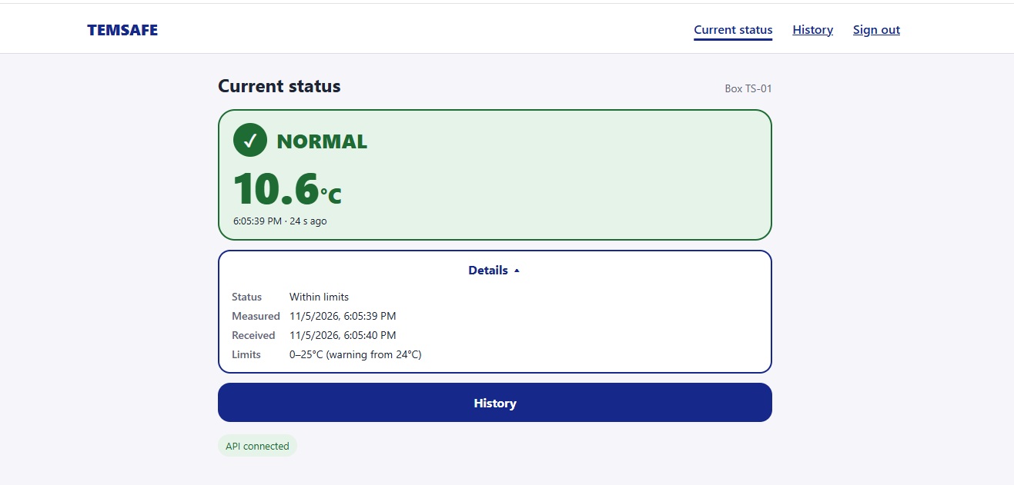
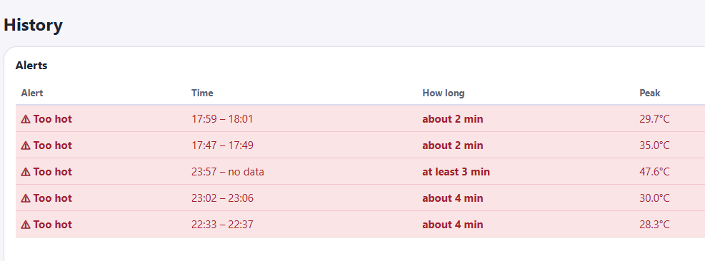
Usability Evaluation Findings & Planned Improvements
!
Alert: High temperature detected
View
1
2
1. Current Status: Show an unread temperature alert and add a View event button.
Last measured: 11/05/2026 6:05pm
2. Details: Remove duplicated information and show one clear timestamp —
Last measured.
Date
5 Nov 2026
3. History: Add the date to each event.
3

Slide 2
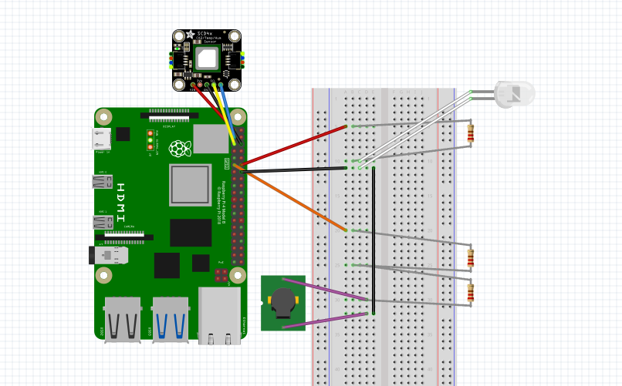
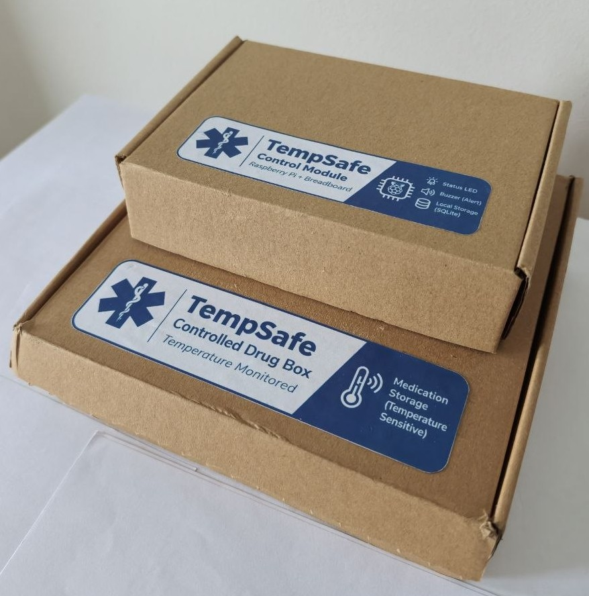
Hardware & IoT Prototype
Components
SCD41 temperature sensor
Raspberry Pi 5
Single-colour LED
Passive buzzer
Three 220 Ω resistors
Breadboard and jumper wires
What the system does
The SCD-41 measures the temperature approximately every 30 seconds. Readings are stored locally in SQLite and sent via MQTT.
Warning → 💡 LED ON
Alert → 💡 LED ON + 🔊 Buzzer ON
Normal → ⛔ LED OFF + 🔇 Buzzer OFF
Two-module prototype
Drug Box: medication + temperature sensor
Control Module: Raspberry Pi + LED + buzzer
The Raspberry Pi is kept outside the monitored box to reduce heat influence on the sensor.

